Slide 1
Using CET Designer as a Sales Tool

Slide 2

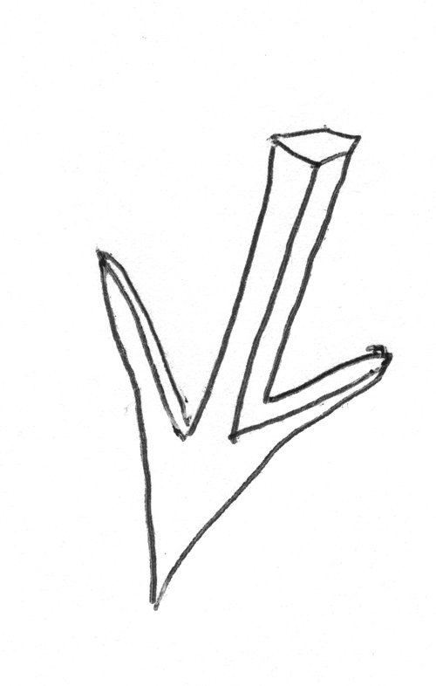
Canfield Business Interiors – 4 1/2 years (Haworth Dealer)
Located in Sioux Falls, SD
Bachelor of Science in Design – 2003/Master of Science in Architecture (Specialization in Interior Design – 2008 (University of Nebraska-Lincoln)
Using CET for 4 years
Recently appointed a CIDA (Council for Interior Design Accreditation) Site Visitor

Slide 3
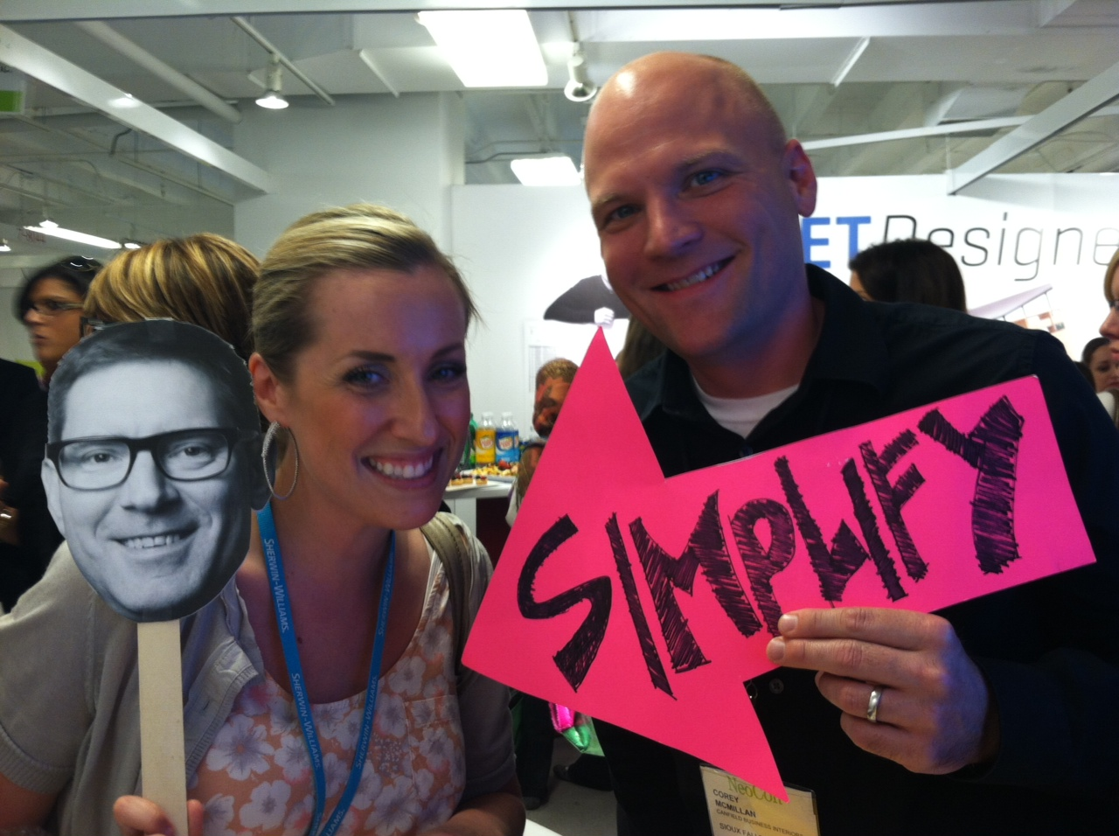
Designers are also the Sales People/Account Managers
Creates less revisions
Designer goes to every meeting, never misses a detail
Client has one point of contact to ease confusion

Slide 4
Corresponence with A&D Firms

Slide 5

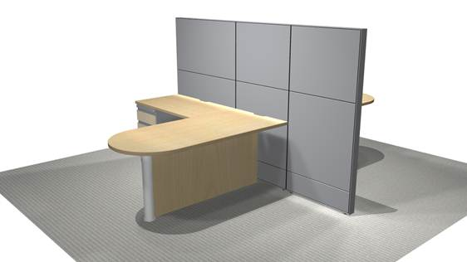
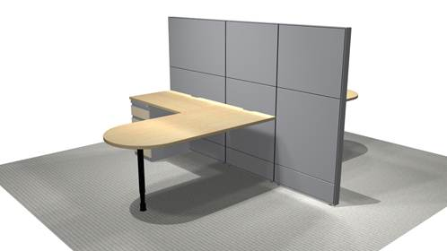
Easy to give other designers and architects renderings for their meetings.
Can portray the designers intention quickly and give alternative ideas with out much effort

Slide 6
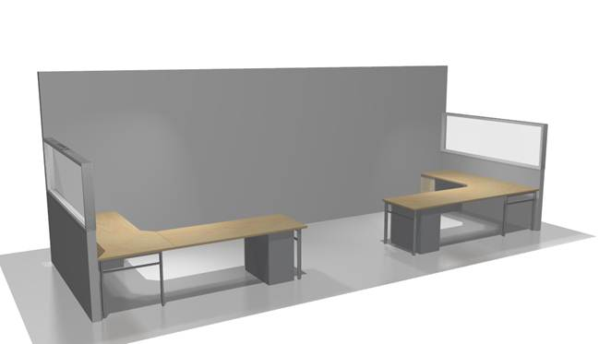
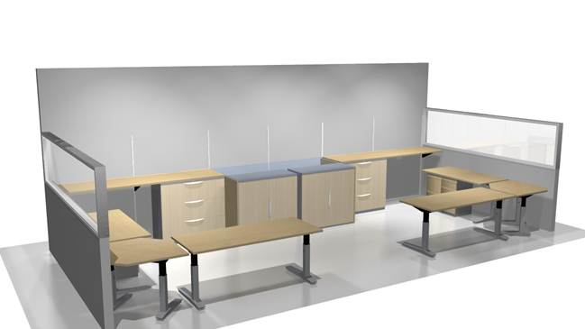
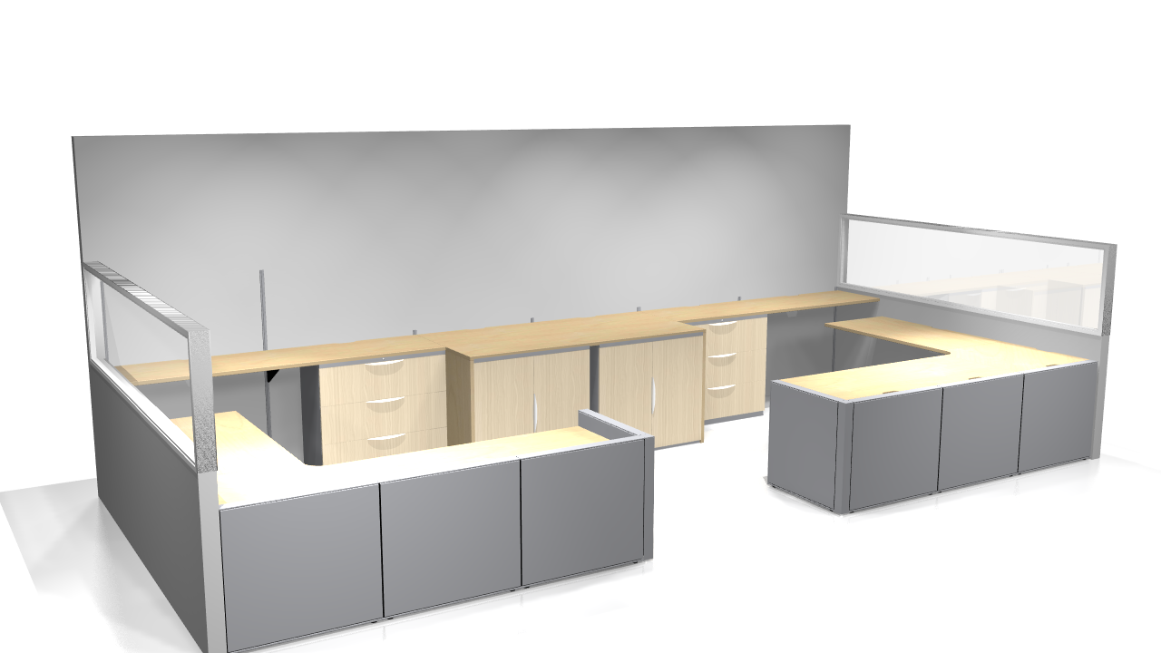
Quickly create options for workstation design by utilizing the “alternative” feature.
Effectively communicate in both 2D and 3D the options available to the A&D with out taking an intense amount of time to do so
Ultimately won the project because of her comfort level with me and my ability

Slide 7
Creating Budgets

Slide 8
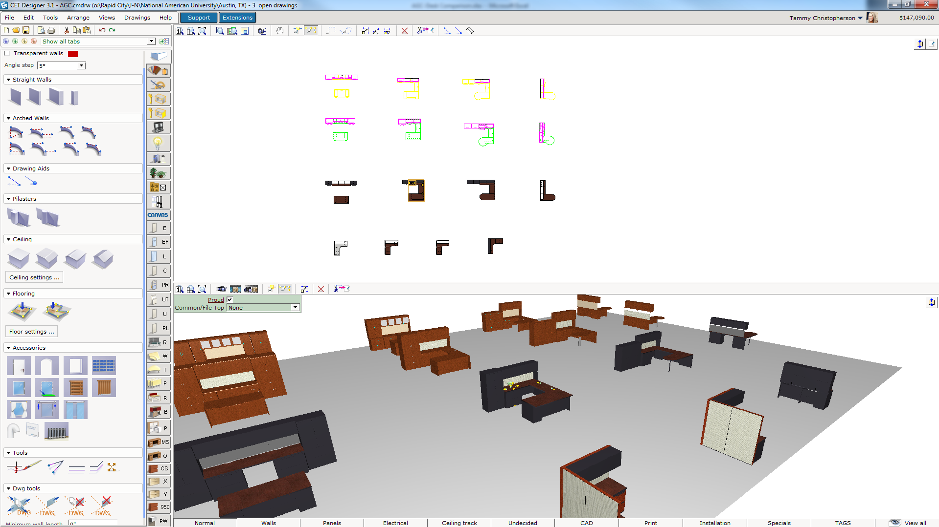
Open a new document
Insert each typical to be priced in the finishes selected
If no finishes are selected, pick a neutral inoffensive option

Slide 9
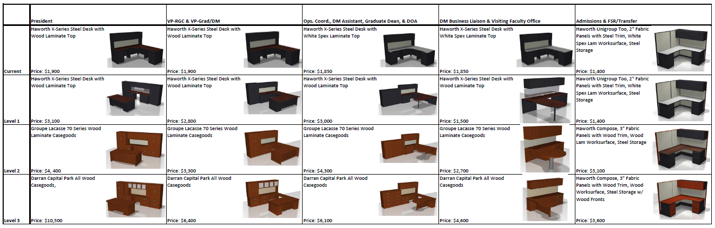
Render each typical separately
Arrange into an Excel spreadsheet
Able to create budget numbers and renderings simultaneously
No confusion from the client as to what they are getting at each price point

Slide 10
Proposal Illustration

Slide 11
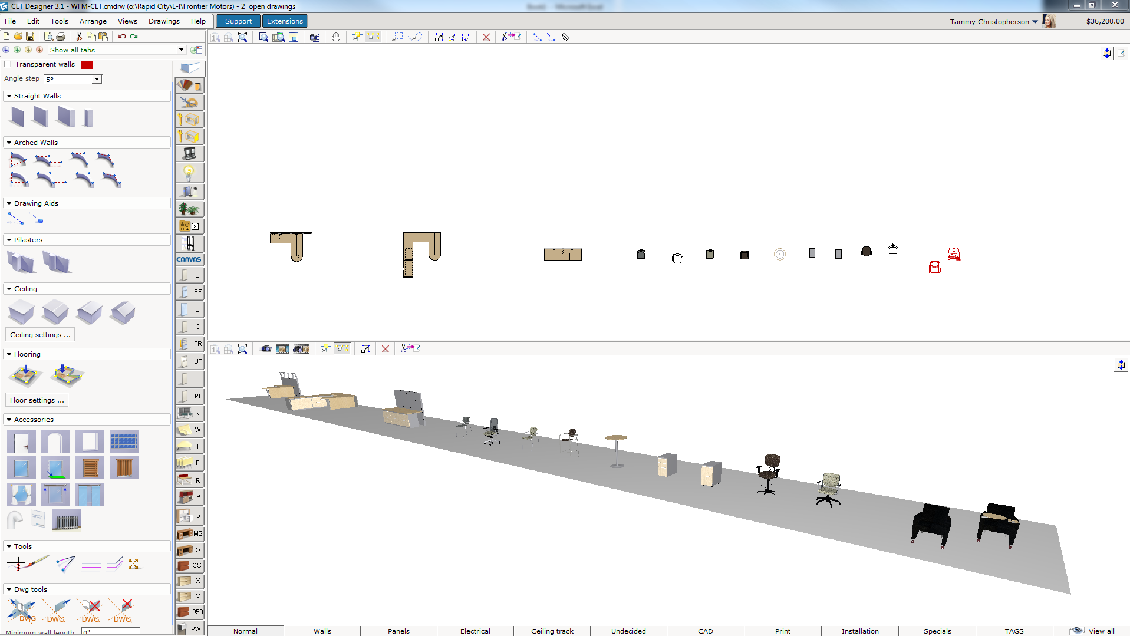
Open a new document
Insert each typical to be priced in the finishes selected
If no finishes are selected, pick a neutral inoffensive option

Slide 12
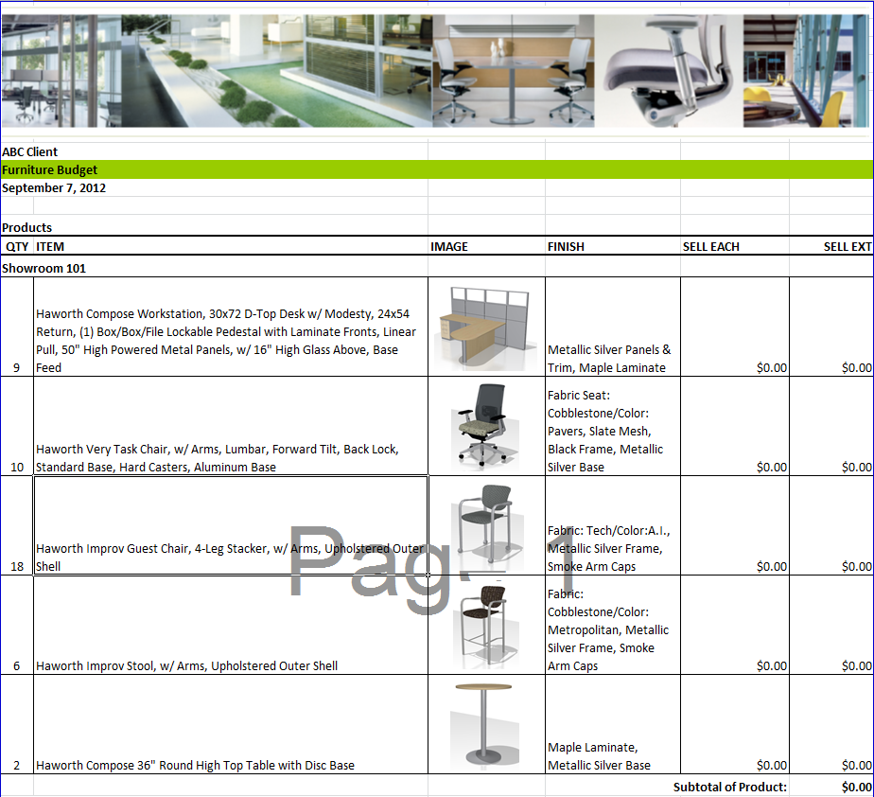
Render each typical separately
Arrange into an Excel spreadsheet
Able to create accurate representations of product to be purchased
No confusion from the client as to what they are getting at each price point
Alternative to using catalogs and websites to describe to the client what their reception area Receive instant feedback on the overall design by using such visually detailed renderings.

Slide 13
Creating Presentation Renderings

Slide 14
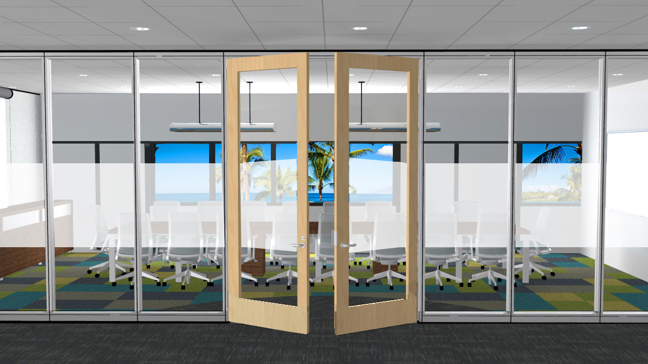

Slide 15
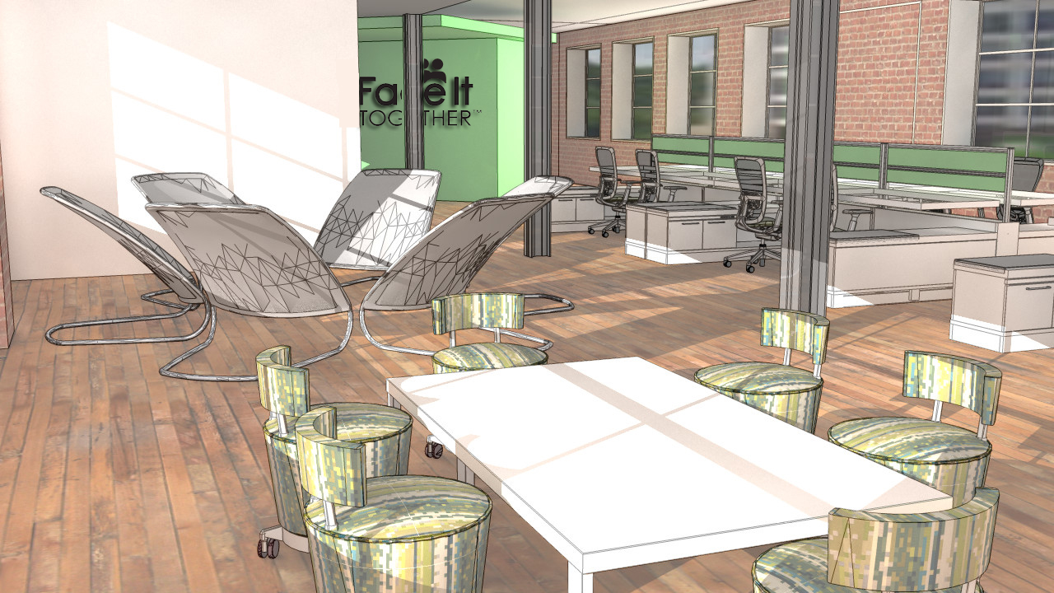

Slide 16
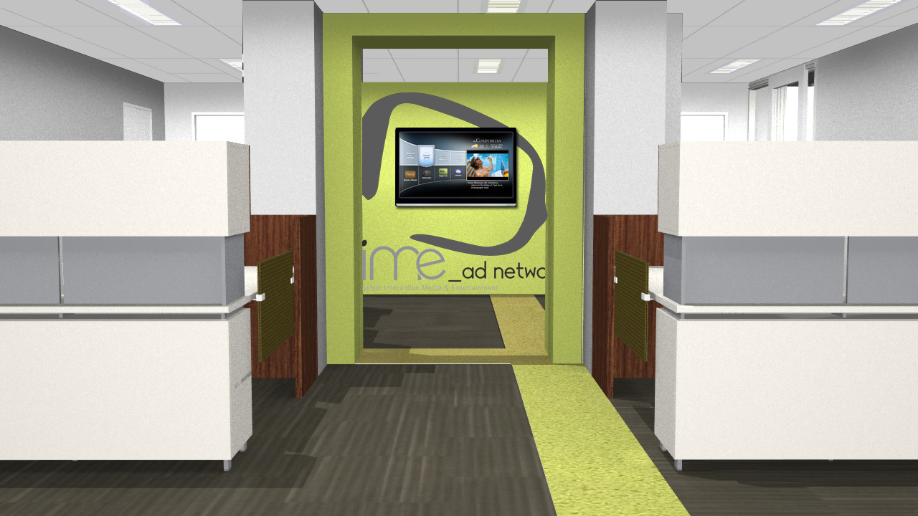

Slide 17
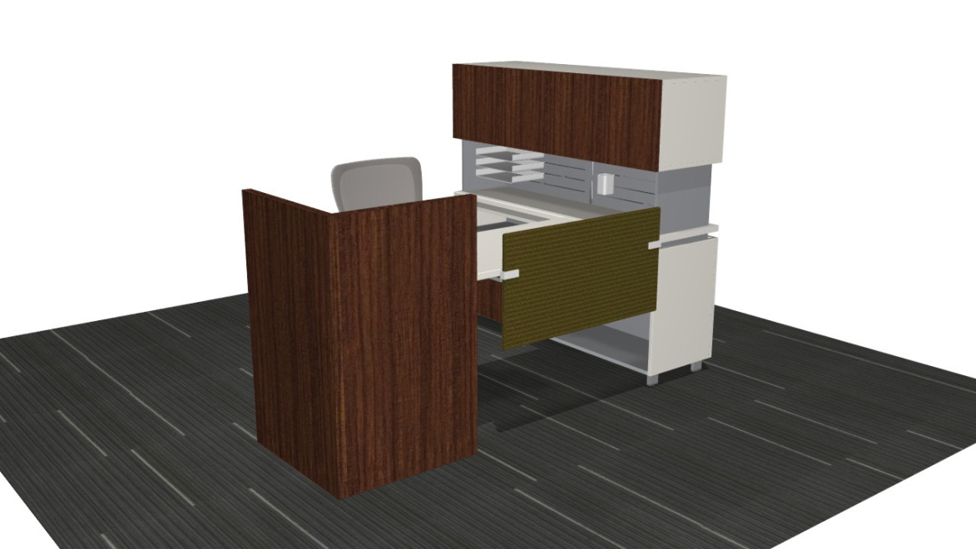
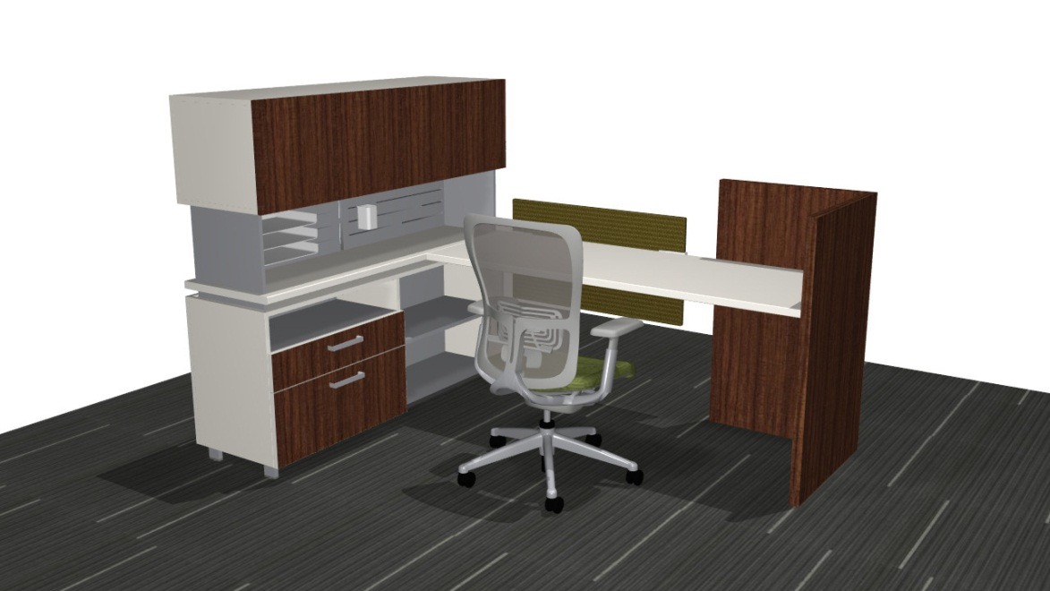

Slide 18
Ability to Interface at a Distance

Slide 19
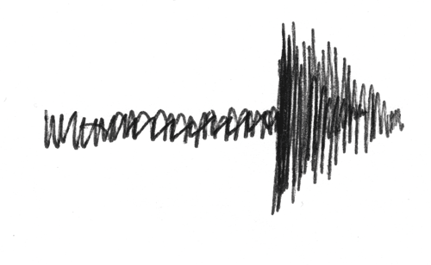
  Effective way to communicate as project develops via webinar vs. on site
  A tool to help client visualize every aspect
  When on site, able to make changes on time, department by department
  This allowed the designer to only make one site visit to finalize the layout of each department.
  Made our design development phase of the project much more effective with the limited amount of time we are generally able to spend onsite.

Slide 20
Design Development Meetings

Slide 21
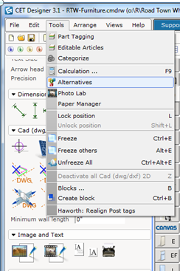
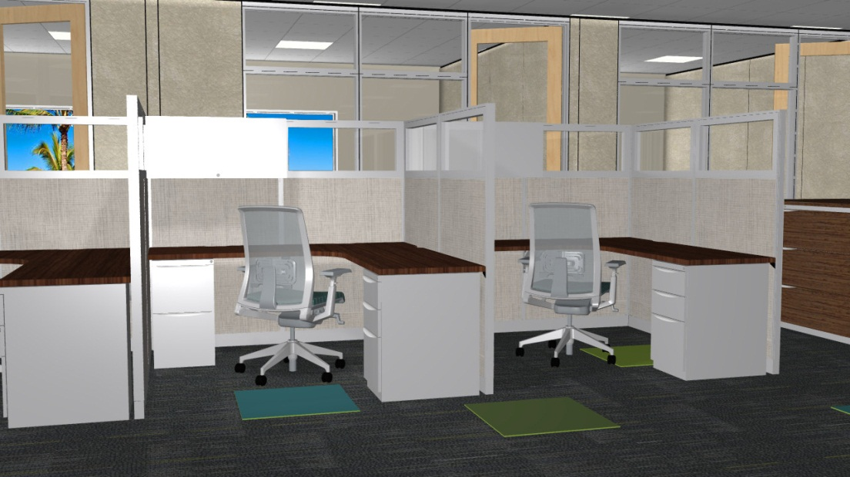
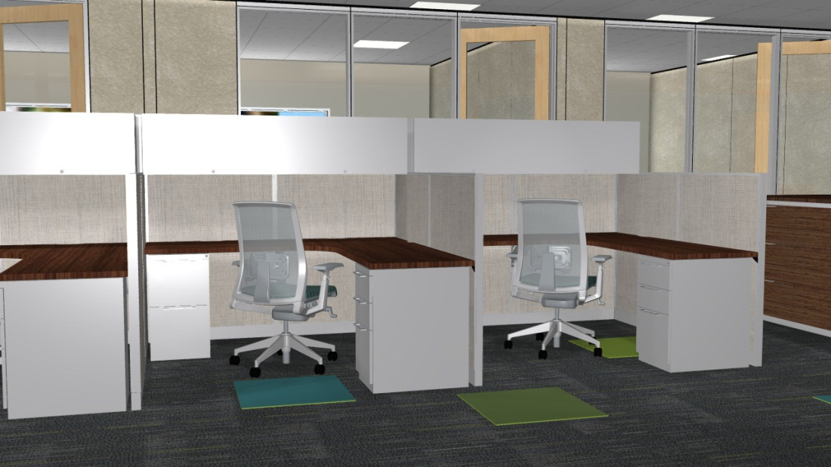
Open a new drawing, Create the proposed workstation typical
Then create alternatives
Render and save.
Send these to the client for initial review of workstation design details (or meet in person, whichever you prefer)
Get approval and move on to overall plan

Slide 22
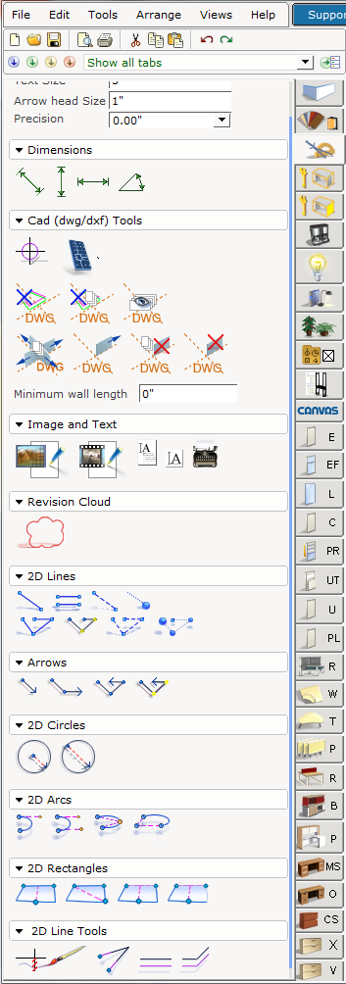
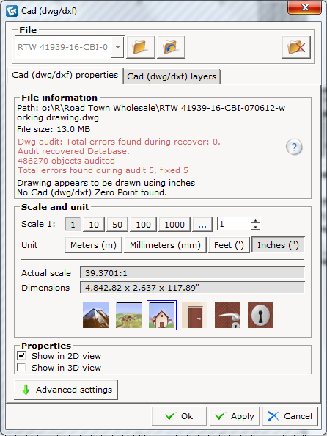
Bring in CAD Background
Have designer draw all workstations and necessary layouts prior to meeting with the client.

Slide 23
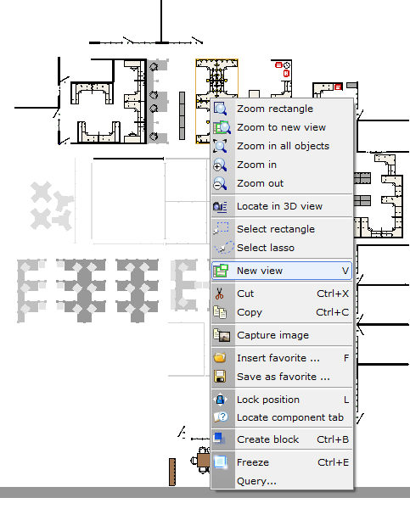
Now Select each section individually, right click and select “Freeze”. Or Press ctrl + E after selecting the section
You have to select each section separately or else it will not work correctly when you go back in with the client sitting with you.
Once you are finished, everything will be grey and flat.
Save the drawing to your Laptop desktop and the server

Slide 24
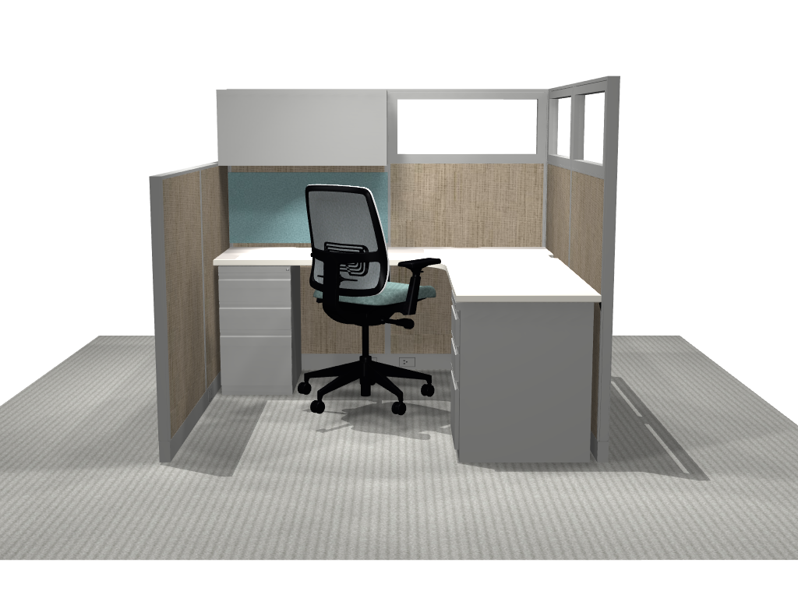
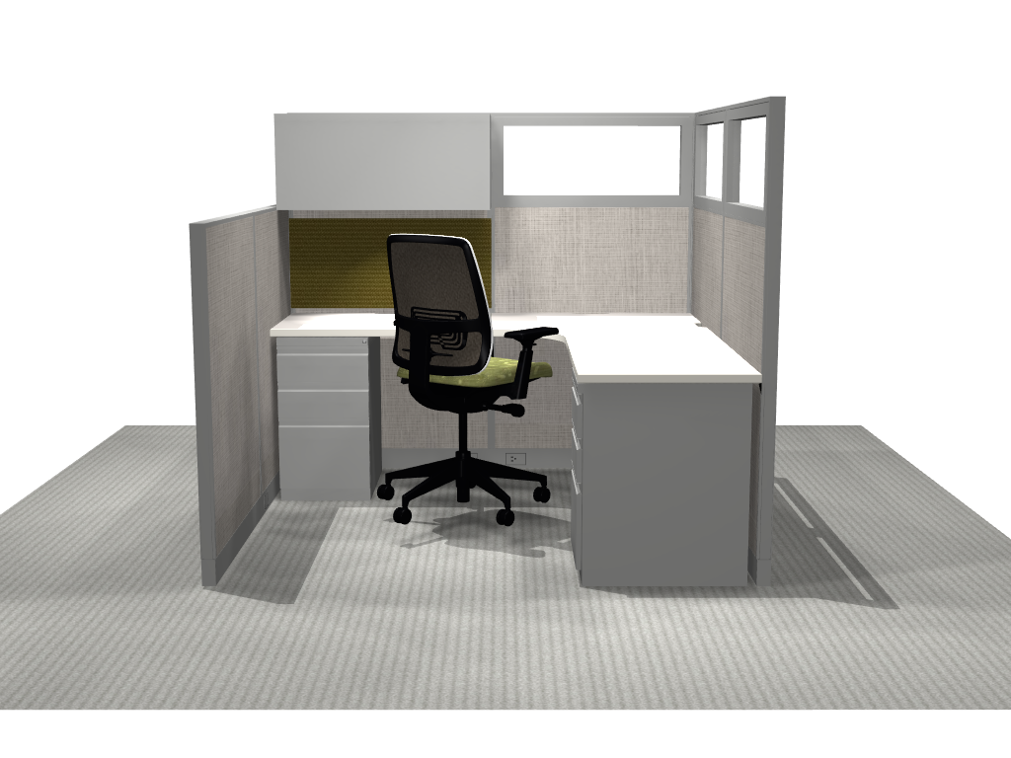
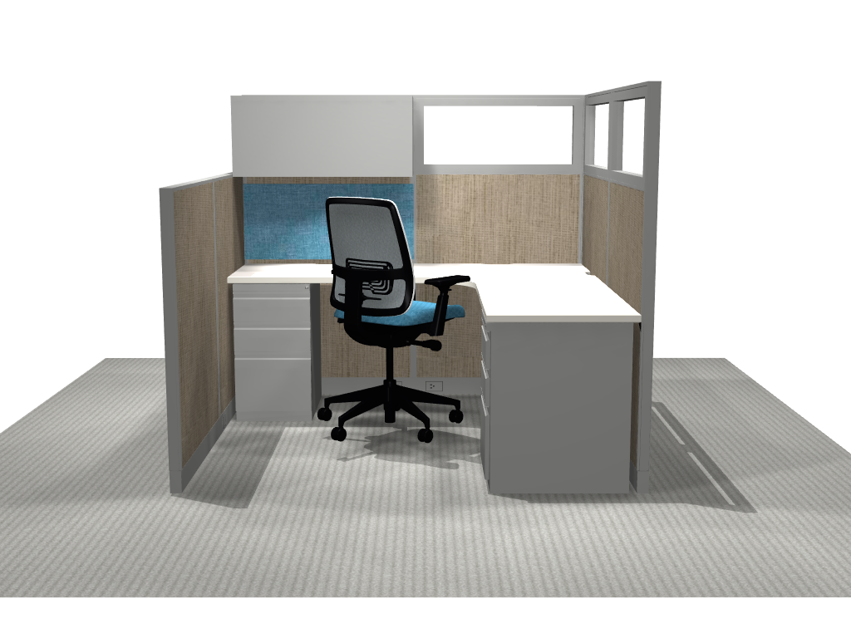
Open a new drawing and create an individual typical workstation in detail.
Apply different color pallets, save for presentation
Ability to make quick material changes, thus enabling her to effectively show a client what their decisions look like immediately
Allows the client to feel confident in the selections they were making

Slide 25
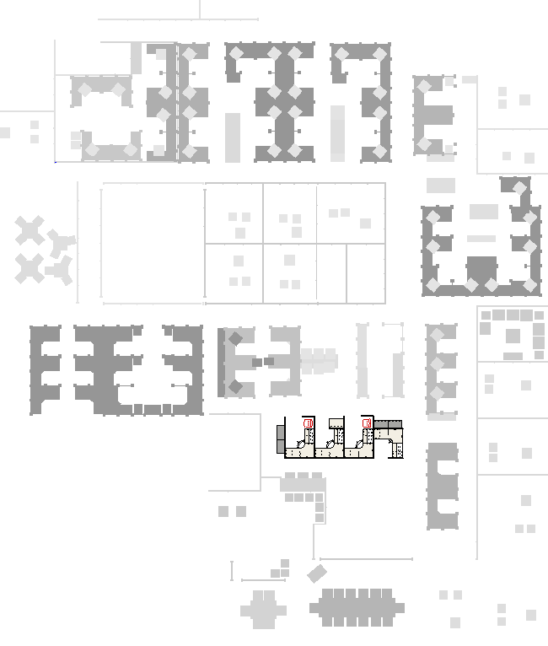
Open the large drawing with all areas frozen.
Select 1 department and Unfreeze.
Freeze tool allows the designer to isolate the various departments and make changes to that specific area without disrupting the entire plan.
Each department is able to focus on their workstations only, without being distracted by the other department layouts.

Slide 26
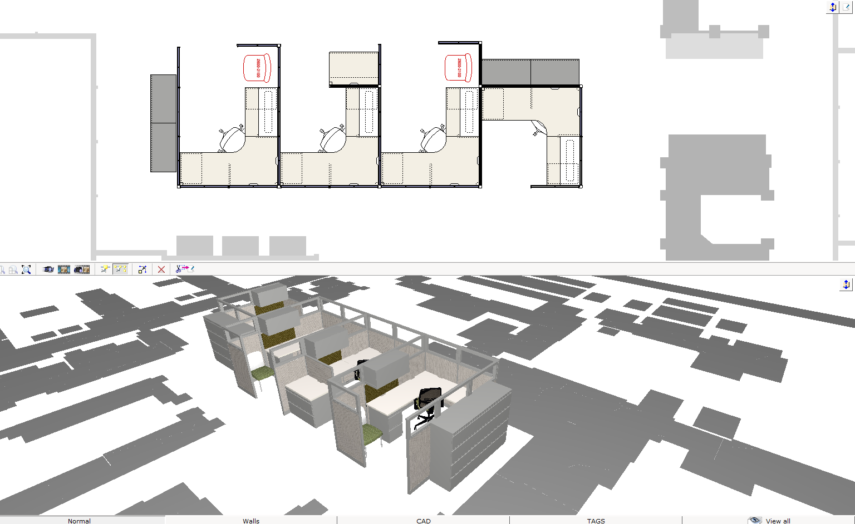
Zoom in and work with the client.
Freeze and Unfreeze
Able to make any of the changes quickly, which allowed for an accelerated turn around time
Utilizing the split screen capability the client is able to watch their department evolve as the designer worked in the 2D view
Decisions are made more confidently, knowing they could see exactly what they were getting
Notes:
Open the large drawing with all areas frozen.
Select 1 department and Unfreeze.
Zoom in and work with the client.
Freeze and Unfreeze

Slide 27


